Slide 1
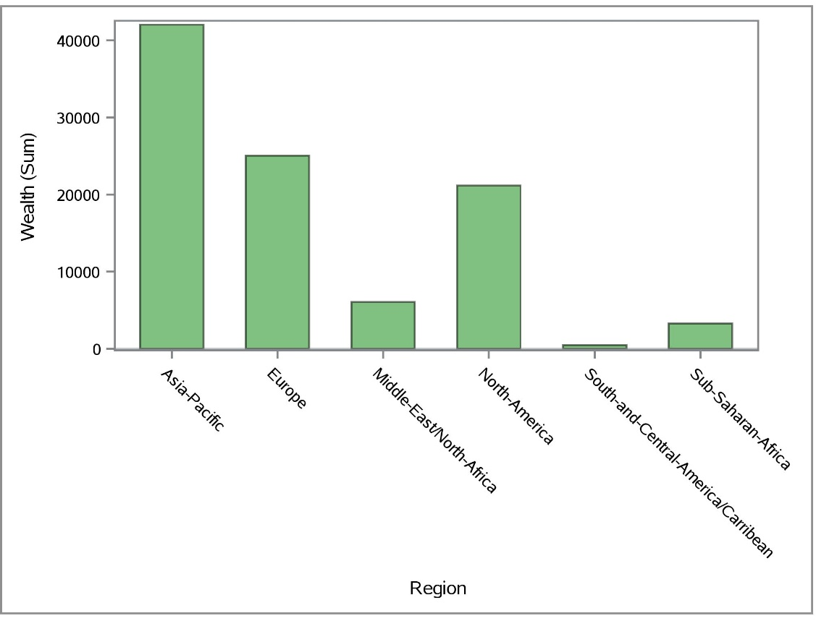
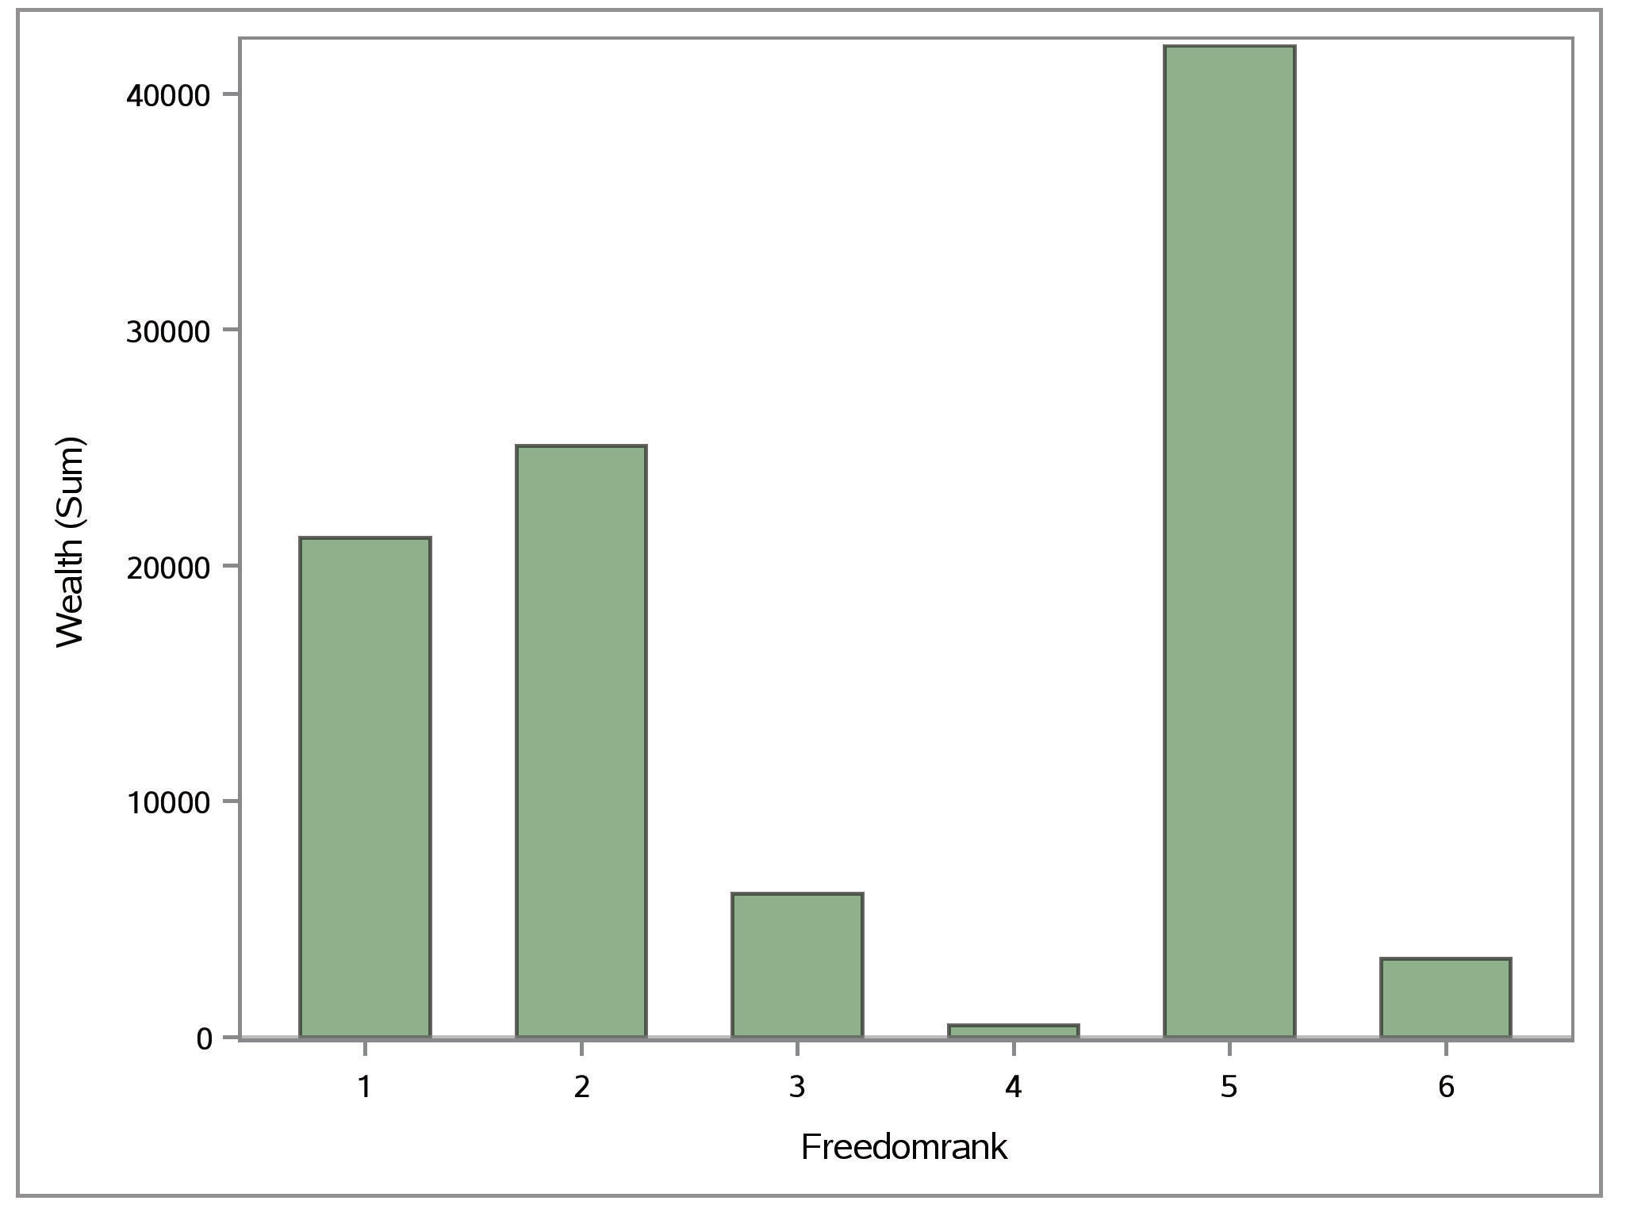
Combined Wealth of Countries within a Region
Freedom Rank to Region

Slide 2
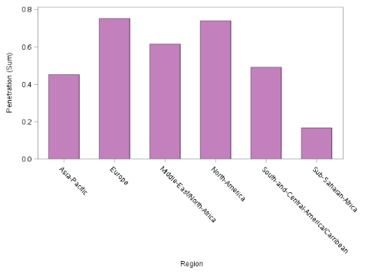
Internet Penetration Percentage by Region

Slide 3
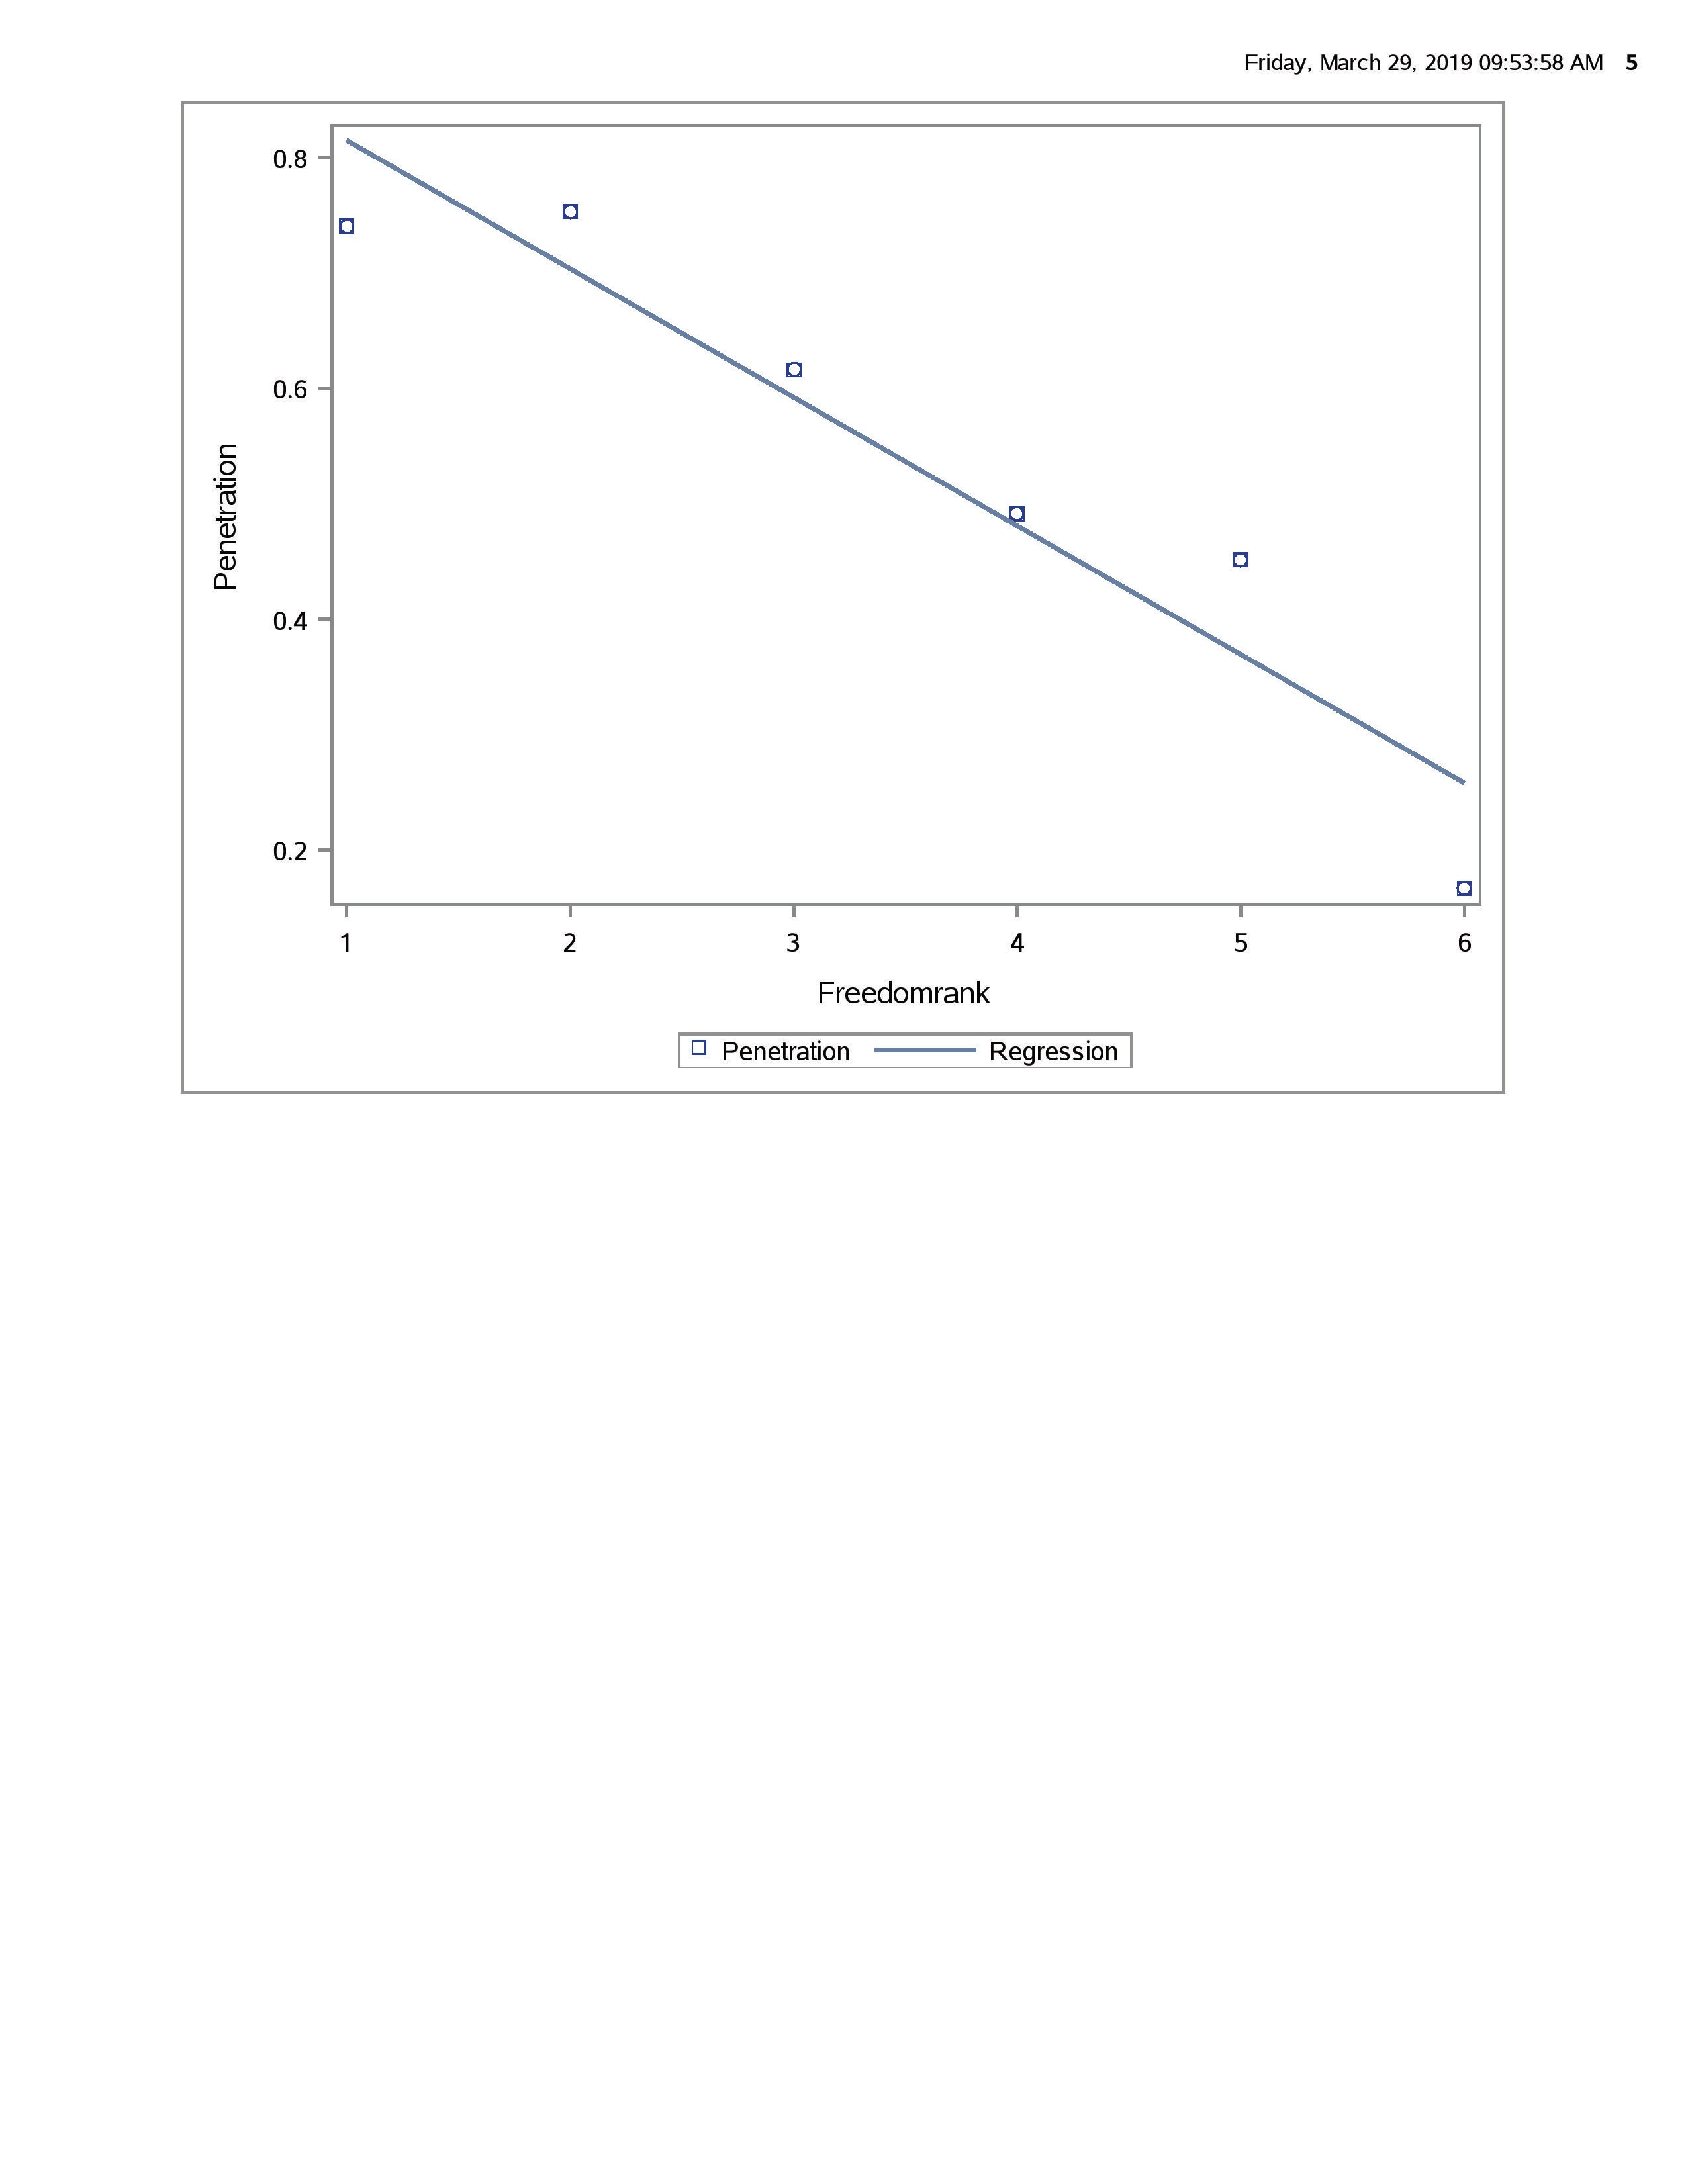
Internet Penetration by Freedom Rank

